Slide 1

Internet of Things Security
Lecture 1: Introduction to IoT
Mehmoona Jabeen Mehmoona.jabeen@mail.au.edu.pk
Department of Cyber Security, Air University

Slide 2
Course Outlines
Introduction to Internet of Things
Hardware architectures and embedded system
Embedded Operating systems for IoT devices
Firmware development and management
Communication Protocols for IoT
IoT Attack vectors and Threat Modelling
IoT security analysis and vulnerability assessment
IoT Application security and their challenges
IoT Data security and challenges
Security issues in Edge Computing based IoT architecture

Slide 3


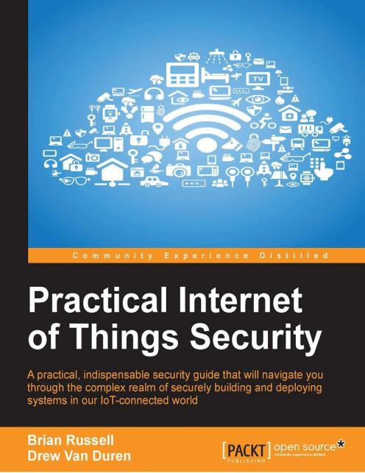
Readings
Selected research articles with each lecture
Selected chapters from the following books

Slide 4
Class Information
Subject:
Internet of Things Security
CGR Code:
5s5sx3n

Slide 5
Lecture Outlines
What is IoT?
Enabling technologies
Characteristics
Growth and Challenges
IoT Security needs
IoT Attack surfaces and vulnerabilities
Common Vulnerabilities Reported
Known Attacks in IoT

Slide 6
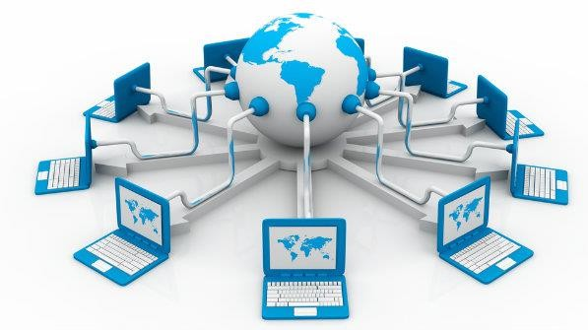
What is internet?
What is Internet?
A global network of computers providing a variety of information and communication facilities, consisting of interconnected networks using standardized communication protocols.
World Wide Web or the Web is only one of a large number of Internet services. The Web is a collection of interconnected documents (web pages) and other web resources, linked
by hyperlinks and URLs.

Slide 7
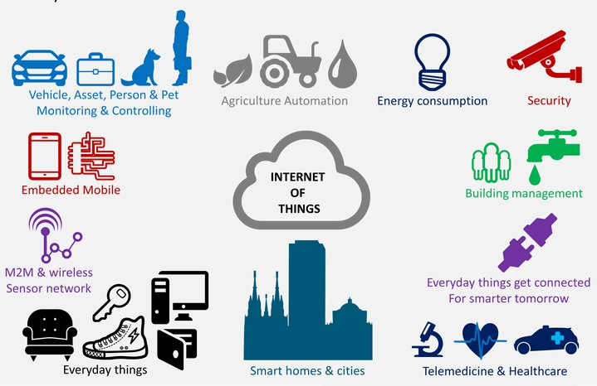
Internet of things
Elaboration
The Internet of Things (IoT) is the inter- networking of physical devices, vehicles (also referred to as "connected devices" and "smart devices"), buildings, and other items embedded with electronics, software, sensors, actuators,and network connectivity which enable these objects to collect and exchange data.
Src: Wikipedia
10

Slide 8
Internet of things: introduction
The IoT has four fundamental building blocks;
be identifiable (Recognizing Things)),
To process (Think and Decide)
to communicate (Talk to Other Devices)
to interact (Take Action Based on Data)

Slide 9
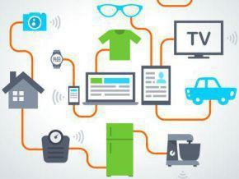

Other terminologies
oMachine-to-Machine Communication (M2M)
oCyber Physical System (CPS)
oInternet of Everything (IoE)
Things develop into human like society and co-work

Slide 10




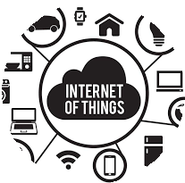
IoT Growth Path
Pre- Internet
Internet of Contents
Internet of Services
Internet of People
Internet of Things
Web 2.0
Service
Web:
Social Media
Machine
Human- to- Human
Fixed and mobile phone
SMS
Fax
Machine
-to-
Human
Informati on
Email
Entertain
ment
-to- Machine
Smart metering
Smart
City
Smart Home
to service commun ication using XML, JSON
etcFor
example,
Social networki ng and message exchang e on facebook
, twitter, skype

Slide 11
Enabling Technologies
RFID for Identification and Tracking technologies.
WSN for sensing and monitoring
IP for addressing and networking
WPAN for low power communication
WPAN
IPv6
WSN
RFID

Slide 12
Pervasive sensing/computing
Driving, walking, sleeping, static
Anytime
Healthcare sensors, jet engines, etc
implantable sensors, soil sensors, underwater
Anywhere
Internet of Things
Anything
Thousands of sensors in KM^2
Anyplace
Anyscale
Underground metros, drones, oceans

Slide 13
IoT Devices embedded with sensors report Data to their
corresponding entities (Consumers, Commercial Businesses, Governments).
Entities send command over the
Internet using Remotes/ Interfaces (Smartphone, tablet, etc) to actuate them.
The Data generated by IoT Devices
is stored at multiple locations including local databases, Cloud employing Data Analytics.
Internet of things Security © Mehmoona Jabeen
Source: BI Intelligence
Report [4]
16

Slide 14
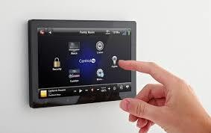
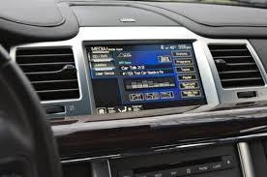
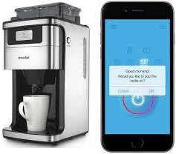
Internet of Things (IoT): Evolution
oWe already have many things like Cars, Homes, Machines, Industrial equipment
connected to Internet
oThey can automate systems for us, allow us to communicate easier, collect data for us
oWhether we know it or not but Internet of Things was already there!

Slide 15
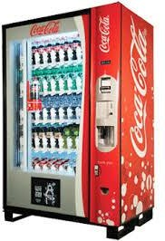
First IoT device
oCoke Machine Introduced in 1982 by Carnegie Mellon University students Mike Kazar, David Nichols, John Zsarnay and Ivor Durham, in the Computer Science department
coke$ status
ROW1 3 Bottles
ROW2 5 Bottles
……
Total of 15 EEMPTY

Slide 16
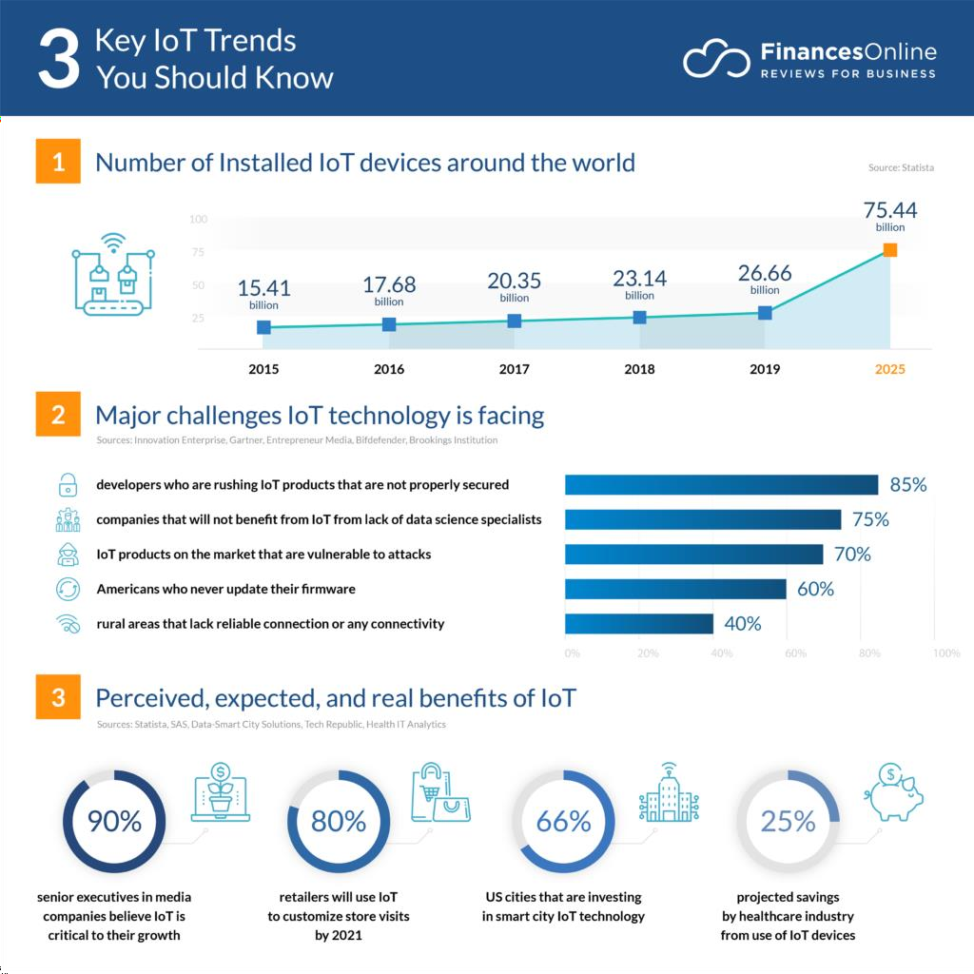
BUT: The amount of Internet connected things is about to EXPLODE
Source: https://financesonline.com/iot-
trends/
Internet of things Security © Mehmoona Jabeen
19

Slide 17
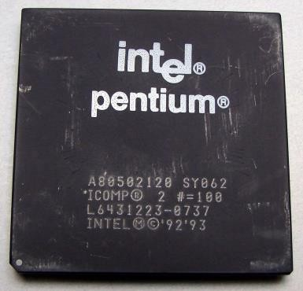
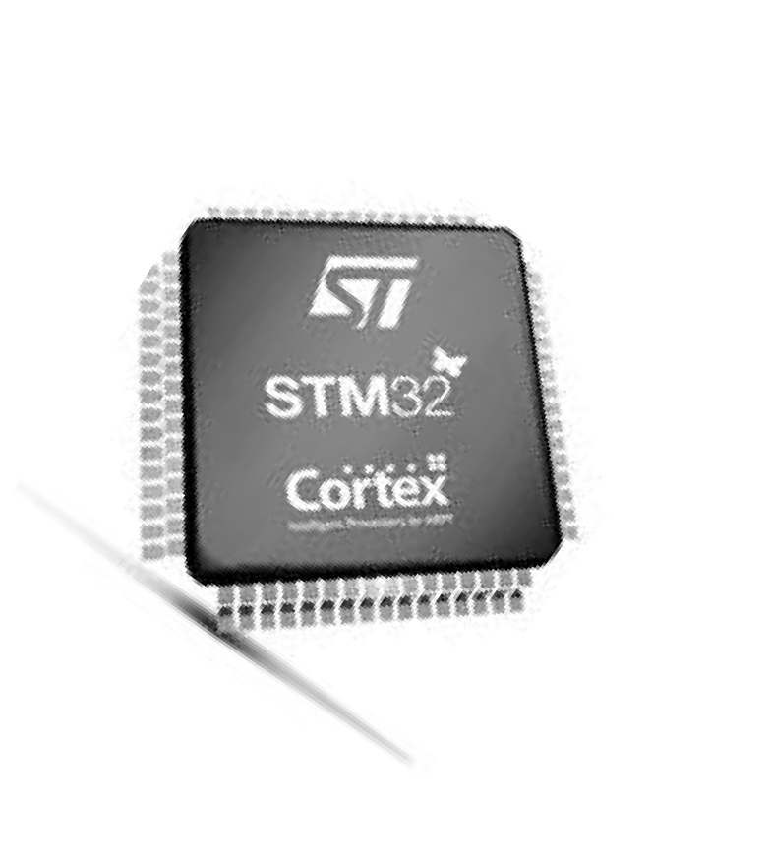
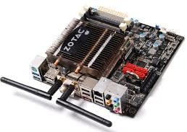
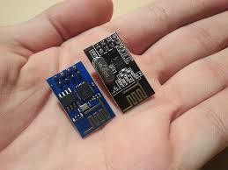
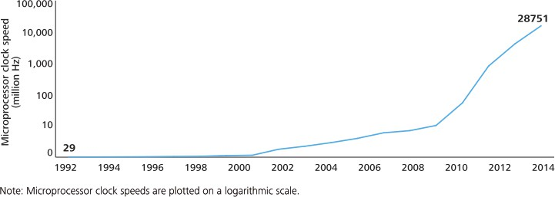
Why is it Now?
1. Fast, low-cost and small form factor silicon devices
Pentium in 1993,
60MHz @
$878
STM3 2 F4,
180M
Hz
$3@
Computing Speed is increasing by Moore’s Law
Internet of things Security © Mehmoona Jabeen
20

Slide 18
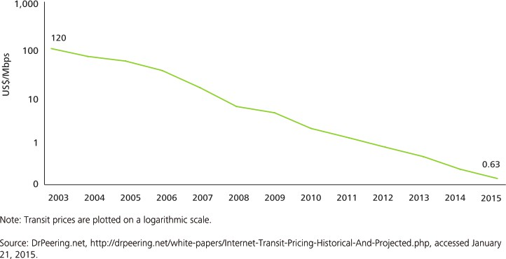
Network capacity
2. Networking progress: more bandwidth at low cost
56K Dial-up MODEM
150Mbps in IEEE 802.11n

Slide 19



Why is it Now?
IPV6 rollout: can handle 340 trillion addresses.
Low power wireless communication technology

Slide 20
Why is it Now?
3 TB per Month in
1992
60,144 TB in
2014
396 exabytes per
month by 2022
5. Big data tools available for storage and analytics
e.g. Hadoop, Apache Spark, Twitter Storm etc

Slide 21
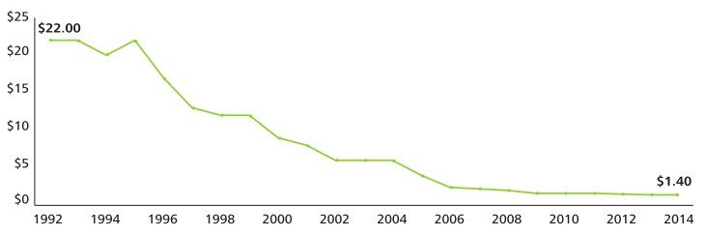
Why is it now?
Adoption of Sensor Technology
Cheap Sensors, e.g., the average cost of an accelerometer now stands at 40 cents,
compared to $2 in 2006.
Smaller sensors: a rapid growth in the use of smaller sensors due to Micro-electro- mechanical systems (MEMS) sensors
Smart Sensors

Slide 22
Convergence of technologies
Sensor Miniaturization
Computing & Electronics
Data Analytics
Ubiquitous Connectivity
Internet of Things
Cloud Computing
Adoption of IP–based networking

Slide 23
Convergence of technologies
For IoT, number of billions of connected devices is an indicator of IoT. The connectivity is just an enabler but the real value of IoT is on data (business insight/data-driven economy)
For Big Data, data collection is one of the main concern, and IoT can play an
important role for data collection and data sharing
For Big Data, data is nothing without real business value insight
Cloud offers Everything as a Service business model for IOT and big data.
IoT is a King, Big data is a Queen and Cloud is a Palace

Slide 24
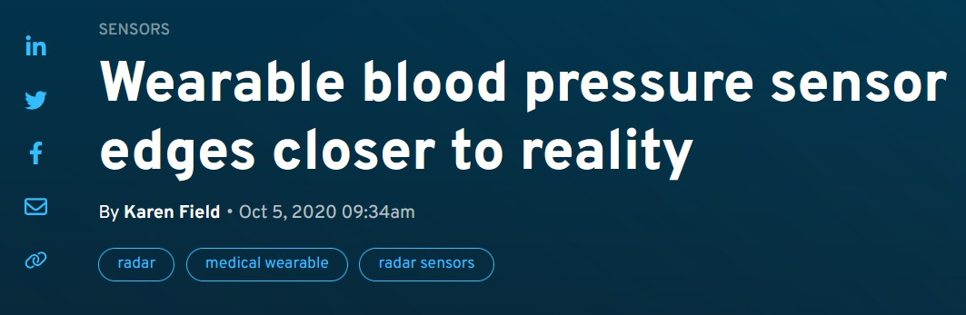
Technologies: Sensors
Types of Sensors: Potentiometer, motion sensor, Accelerometer, gyroscope, Barometer, humistor, soil moisture sensor, acoustic, infrared, Thermometer, smoke/gas sensor, blood glucose biosensor, pulse oximetry, electrocardiograph
Size of sensor
Cost of Sensor
Accuracy of sensors
Integration in different devices
Data gathering and mining techniques
Energy efficient algorithms and protocols

Slide 25
Technologies: networking
Why IP?
Most of the IP based technologies already exist, well known and proven to be working.
The pervasive nature of IP networks allows use of existing infrastructure.
IP Address Space
IPv4 address space exhausted and next version IPv6 developed BUT
6LowPAN: Adoption of IPv6 for IoT
More suitable for higher density (128 bit Address)
Statelessness mandated
No NAT necessary (adds extra cost to the cost prohibitive WSN)
Possibility of adding innovative techniques such as location aware addressing
Larger address width (Having efficient address compression schemes may alleviate this con)

Slide 26
Cloud storage/analytics platforms
Amazon Web Services (AWS) IoT Platform
It provides device Software development Kit, a secure device gateway, registry for device
recognition, device shadows (virtual devices), and rules engine
Cost per million messages is as low as $5
Microsoft Azure IoT Suite
Google Cloud Platform
Google Brillo is a great starting point for IoT development.
IBM Watson IoT
ThingSepak
Carriots
ThingWorx

Slide 27
Whats IoT Security
An IoT attack whose goal is to (negatively) affect the interaction between a CPS and the
physical world
Originates through any attack surface
cyber, physical, or any combination of cyber/physical
IoT security concerns the development of technologies for defending against these
attacks
e.g., discovering new vulnerabilities, techniques for detection/mitigation/recovery, ...

Slide 28
IoT Attack Surfaces
Cyber attack surfaces
e.g., communication, networks, computers, databases, ...
Physical attack surfaces
e.g., locks, hardware ports, cables, ...
Environmental attack surfaces
e.g., GPS signal, electro-magnetic interference, battery draining/cycling/heating, ...
Human attack surfaces
e.g., phishing, bribing, blackmail, etc.

Slide 29
OWASP Attack Surfaces and Vulnerabilities
Attack Surface | Vulnerability
Ecosystem Access Control | Implicit trust between components Enrollment security Decommissioning system Lost access procedures
Device Memory | Cleartext usernames Cleartext passwords Third-party credentials Encryption keys
Device Physical Interfaces | Firmware extraction User/admin CLI Privilege escalation Reset to insecure state Removal of storage media
Device/Mobile/Cloud Web Interface | SQL injection Cross-site scripting Username enumeration Weak passwords Known default credentials

Slide 30
OWASP Attack Surfaces and Vulnerabilities
Attack Surface | Vulnerability
Device Firmware | Hardcoded credentials Sensitive information disclosure Encryption keys Update sent without encryption Updates not signed or malicious
Device Network Services | User/Admin CLI Denial of Service Unencrypted Services UPnP & Vulnerable UDP Services
Administrative Interface | SQL injection Cross-site scripting Username enumeration Weak passwords Known default credentials Two-factor authentication
Local Data Storage | Unencrypted data Data encrypted with discovered keys Lack of data integrity checks

Slide 31
IoT Vulnerability Reports
Hardware based security challenges in IoT
Limited processing power to integrate security
CVE-2018-6932 – Code vulnerable to DoS attack due to excessive system resource consumption [3]
IP fragment reassembly code in FreeBSD before 11.1-STABLE is vulnerable to a denial of service due to excessive system resource consumption. This issue can allow a remote attacker to send an arbitrary IP fragments to cause the machine to consume excessive resources.
Device heterogeneity makes it difficult to secure
Same architecture but various OS functionality
Integrating storage and computational process
CVE-2018-3619 – Information disclosure vulnerability allows attacker to recover data via physical access [4]
Storage media in systems with Intel Optane memory module with Whole Disk Encryption may allow an attacker to recover data via physical access.

Slide 32
IoT Vulnerability Reports
Hardware based security challenges in IoT
Embedded system interfaces like UART, JTAG
CVE-2018-9149 – UART security failure in Wi-Fi System [5]
The Zyxel Multy X (AC3000 Tri-Band WiFi System) device doesn't use a suitable mechanism to protect the UART. After an attacker dismantles the device and uses a USB-to-UART cable to connect the device, he can use the 1234 password for the root account to login to the system. Furthermore, an attacker can start the device's TELNET service as a backdoor.
Managing battery consumption and memory
Simultaneous application and security services
CVE-2018-15671 – Hierarchical Data Format (HDF) library issue, excessive stack consumption detected in the function [6]
An issue was discovered in the HDF HDF5 1.10.2 library. This results in denial of service.

Slide 33
IoT Vulnerability Reports
Firmware security concerns in IoT
Secure Boot to verify firmware integrity at device startup
CVE-2018-18653 – User can bypass secure boot restrictions [7]
Ubuntu 18.10 when booted with UEFI Secure Boot enabled, allows privileged local users to bypass intended Secure Boot restrictions and execute untrusted code by loading arbitrary kernel modules.
Hard-coded credentials like password, e-mails etc.
CVE-2018-15781 – Remote attacker can reverse engineer cryptosystem used by Dell Wyse Password Encoder [8].
The Dell Wyse Password Encoder in ThinLinux2 versions prior to 2.1.0.01 contain a Hard-coded Cryptographic Key vulnerability.
Firmware update mechanism
CVE-2018-9232 – Lack of firmware authentication can lead attacker to craft a malicious firmware and use as an update [9]

Slide 34
IoT Vulnerability Reports
Firmware security concerns in IoT
Exploitation of backdoors left by product developers
CVE-2018-9919 – Factory backdoor allows vendor to extract confidential information via remote root SSH access [10]
Default password for various login interfaces
Web interface and telnet access
CVE-2019-8950 – Network device allows attacker to login to admin account via Telnet [11]
40

Slide 35
Exploiting Vulnerabilities in IoT
A ThingBot is a botnet consisting of devices within the Internet of things.
Vulnerable or infected appliances that are connected to the Internet can potentially pose a
risk to corporate networks.
Number of attacks against Routers, SmartTV, network-attached storage devices, gaming consoles and various types of set-top boxes is increasing.
Many set-top boxes runs on embedded linux or apache operating systems of ARM-like
microcomputers

Slide 36
Principle abuses of IoT Devices
Computational capabilities, increasing capabilities of microcomputers and Internet
connection makes IoT devices a privileged attack tool for hackers.
IoT devices could be used to:
Send Spam.
Coordinate an attack against a critical infrastructure.
Serve a malware.
Work as entry point within a corporate network.

Slide 37
One of the first cases observed
Proofpoint discovered more than 750,000 Phishing and SPAM Emails Launched From
“Thingbots”
Thingbots could be used in an attack against a critical infrastructure from anywhere in the globe
Cyber criminals sent in bursts of 100,000, three times per day, targeting Enterprises and
_{i} Exploited the strength of large number of IoT devices
More than 100,000 Refrigerators, Smart TVs and other smart household appliances have been
hacked.
No more than 10 emails were initiated from any single IP address.
ndividuals worldwide

Slide 38
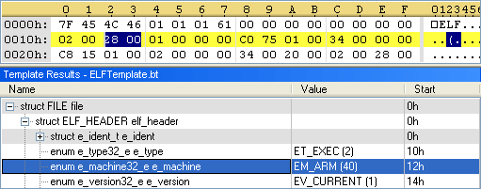
A Linux worm designed to target IoT devices
In November 2013 Symantec detected the worm Linux.Darlloz exploiting the PHP vulnerability CVE-2012-1823 to propagate itself.
Wow ………………………… a new business opportunity
The Linux.Darlloz infected Home Internet kits with x86 chips ( variant for ARM, PPC, MIPS and MIPSEL architectures.
The worm:
i.e.routers) and were discovered
generates random IP addresses and attempts to use commonly used credentials to log into the target machine.
It sends HTTP POST requests specifically crafted, once compromised the target it downloads the worm
from a C&C server and starts searching for other targets.
Once the worm has compromised a device, it kills off access to any Telnet services running.
o
o
Change default settings, adopt strong password, keep updated the software and firmware.

Slide 39
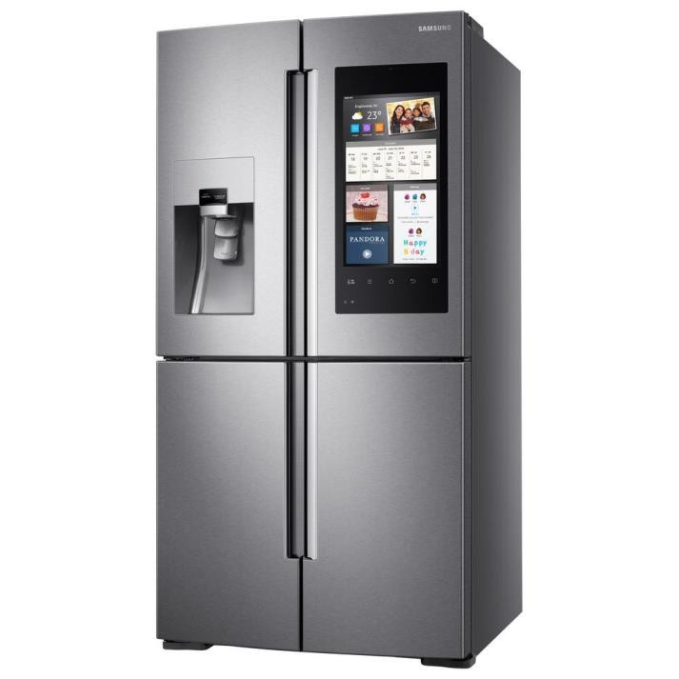
Spike botnet runs DDoS from IoT devices
Akamai spotted a Spike malware which is used to run DDoS attacks through desktops and IoT devices.
Spike toolkit is able to to generate an ARM-based payload
The spike botnet was composed by routers, smart thermostats, smart dr and other IoT devices.
Spike botnet composed by 12,000 -15,000 devices (sept 2014).
Oops … my refrigerator is sending spam messages
SNORT signature analysis suggested to mitigate application-layer GET f
yers, freezers,Raspberry Pi
Mpps). lood attacks.
o One of the attack clocked 215 Gbpsand 150 million packets per second (

Slide 40
Hacking Wearable devices
Data sent between the Smart watch and an Android mobile phone could be intercepted.
An attacker that could be able to decode users' data, including text messages to Google Hangout
chats and Facebook conversations.
Bluetooth communication between most Smart watches and Android devices relies on a six digits PIN.
Easy to crack with a brute-force attack.
Mitigate the attack with NFC pairing procedure in pin code exchange or the use of passphrases.
PoC with Samsung Gear Live smart watch and Google Nexus 4

Slide 41
Hacking Smart Meters
Smart meters can be hacked to hit the National power network
In Spain, millions of Smart meters, are susceptible to cyber attack due to lack of proper security
controls.
8 million smart meters are deployed in Spain (30 percent of households).
Attackers could cause a blackout or conduct fraudulent activities (i.e. billing frauds).
Poorly protected credentials stored in the smart meters.
Attackers could modify device unique ID to impersonate other customer or use the smart meter for launching attacks against the power network.

Slide 42
More Attacks
Mirai botnet
This botnet infected numerous IoT devices, then used them to flood DNS provider Dyn with a DDoS attack. It took down Etsy,
GitHub, Netflix, Shopify, SoundCloud, Spotify, Twitter, and a number of other major websites
Cold in Finland
In November 2016, cybercriminals shut down the heating of two buildings in the city of Lappeenranta, Finland. This was another DDoS attack; in this case, the attack managed to cause the heating controllers to continually reboot the system
Brickernet
that it relied upon a DDoS attack and users not changing the default username/password of their devices. The biggest
difference between Brickerbot and Mirai botnet is that Brickerbot simply kills the device.
BrickerBot malware destroys firmware to form a Permanent Denial-of-Service (PDoS) botnet.
Botnet barrage
more than 5,000 discrete systems were found to be making hundreds of DNS lookups every 15 minutes. The botnet spread via brute force attack to break through weak passwords on IoT devices.

Slide 43
Securing IoT
Demand of connectivity for the Internet of Things(IoT) exploding.
The global network must be able to securely and efficiently handle all these connections.
Lack of standardization in the IoT market.
Every single connection could make networks vulnerable.
Every connected device has a network address. Internet Protocol (IPv6) extends the addressing space
DNS will play an even more central role with the diffusion of M2M connections.
Organizations will need to improve security and prevent DDoS and cache poisoning attacks.

Slide 44
Using Existing Internet Security in IoT
IoT devices communicate among themselves with little human interaction, mutual authentication is a crucial aspect of the paradigm.
Recent attacks like the“smart” light bulb password leaks, hacks of Foscam baby monitors, Belkin
home automation systems, and hacks of smart cars systems are just the beginning.
PKI-based solutions could help to secure exchanging information across the Internet and mutual authenticate the actors.
PKI is already being used to address problems similar to the ones the Internet.
TLS, IPSec, and other data integrity protocols are complex and hard to apply
Existing DDOS and IDS are unaware of devices context.
50

Slide 45
Challenges in IoT Security
Different architecture of IoT
Resource constrained devices
Perception Layer
Device cloning, eavesdropping, spoofing, DoS, etc.
Network Layer Challenges
Sybil attack, Dos attack, Man in the Middle Attack (MIMA) just like eavesdropping attack and
causes Authentication assault
Middle ware Layer Challenges
unauthorized access, DoS, malicious insider.
Application Layer Challenges
Malicious Code Injection (Malicious code injection is another very serious software type attack in which the attacker selects a node and injects a code in the specific node which causes the shutdown of the network or seriously damages the system [7]. ), DoS Attack , Spear Phishing Attack (kind of email spoofing attack) and Sniffing Attack [15].
Application Layer
Middleware
Network Layer
Perception Layer

Slide 46
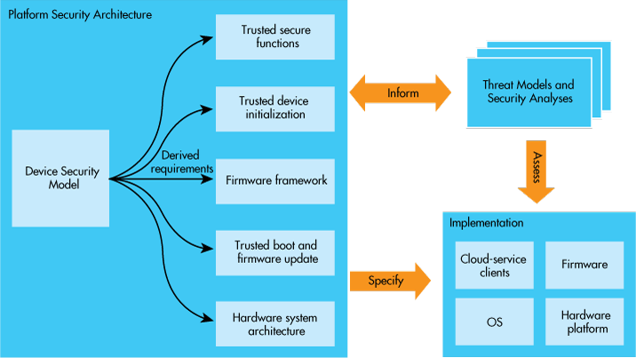
ARM Platform Security Architecture (PSA)
PSA aims to provide end to end security of IoT devices
PSA will simplify the process of evaluating IoT devices against security standards [14]

Slide 47
Traditional Security and IoT
“Traditional network security solutions are well established but due to resource constraint property of IoT devices traditional security mechanisms cannot be deployed directly for securing IoT devices from cyber attacks.“
E. Gaukstern , “Cybersecurity threats targeting networked critical medical devices,” 2018.
To enhance the level of security for IoT, researchers need:
IoT Tools
IoT Datasets

Slide 48
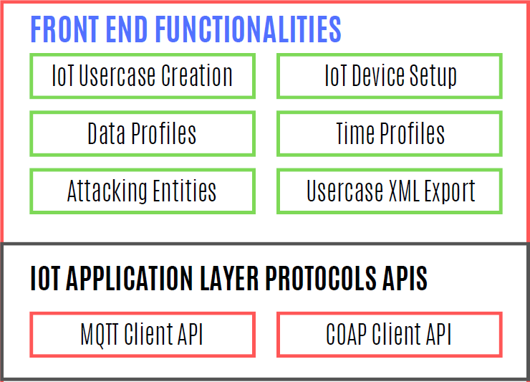

Tool 1: IoT Traffic Generator Tool
Open source tool with easily understandable and extendable code
Link: https://github.com/IRIL-KICS/IoT-Advanced-Data-Generator
Capable of creating the real-time IoT use cases with the support of a large number of IoT devices
Capable of generating the latest IoT specific attacks. That is not supported yet by any other open source IoT traffic generator tools

Slide 49
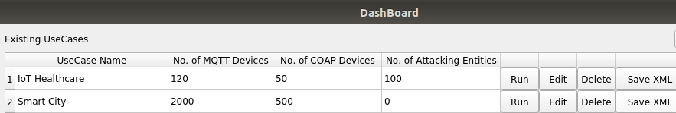
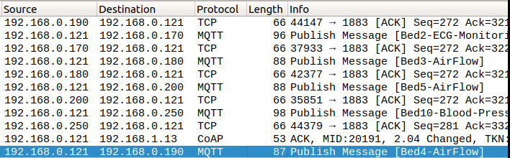
IoT Traffic Generator Tool Screens
Screen 1: Dashboard of IoT Use Cases
Screen 2: IoT Traffic Captured with Wireshark

Slide 50
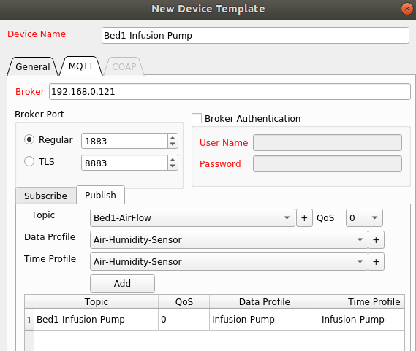
IoT Traffic Generator Tool Screens
Screen 3: IoT Device Setup Screen

Slide 51

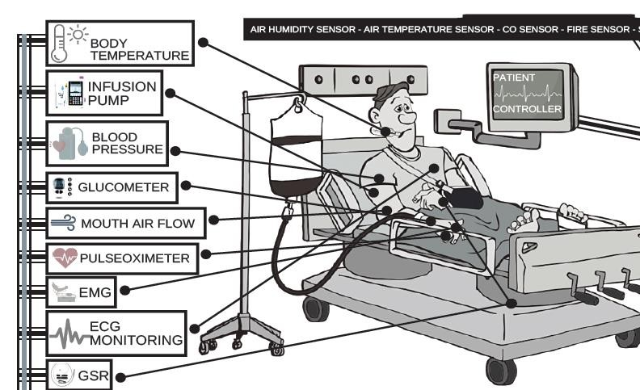
IoT Healthcare System Dataset
Created IoT healthcare dataset with more than 200 IoT devices data.
First dataset with IoT protocols specific features.
Dataset consist of both Normal & Malicious traffic
Ideal for developing Intrusion Detection Systems (IDS) for IoT
Fig 2: IoT Healthcare Dataset

Slide 52
Tool 2: IoT Firewall
The traditional security mechanisms are deployed at two levels i.e. network level or host level. IoT devices are resource constrained, so the host level security mechanisms cannot be deployed on them.
L. Santos, C. Rabadao, and R. Gonc¸alves, “Intrusion detection systems in internet of things: A literature review,” in 2018 13th Iberian Conference on Information Systems and Technologies (CISTI). IEEE, 2018, pp. 1–7.

Slide 53
References
https://iot-analytics.com/state-of-the-iot-update-q1-q2-2018-number-of-iot-devices-now-7b/
Baseline Security Recommendations for IoT - ENISA
https://cve.mitre.org/cgi-bin/cvename.cgi?name=CVE-2018-6923
https://cve.mitre.org/cgi-bin/cvename.cgi?name=CVE-2018-3619
https://cve.mitre.org/cgi-bin/cvename.cgi?name=CVE-2018-9149
https://cve.mitre.org/cgi-bin/cvename.cgi?name=CVE-2018-15671
https://cve.mitre.org/cgi-bin/cvename.cgi?name=CVE-2018-18653
https://cve.mitre.org/cgi-bin/cvename.cgi?name=CVE-2018-15781
https://cve.mitre.org/cgi-bin/cvename.cgi?name=CVE-2018-9232
10] https://cve.mitre.org/cgi-bin/cvename.cgi?name=CVE-2018-9919
https://cve.mitre.org/cgi-bin/cvename.cgi?name=CVE-2018-8950
William J. Buchanan, Shancang Li & Rameez Asif (2017) Lightweight cryptography methods, Journal of Cyber Security Technology, 1:3-4, 187-201, DOI: 10.1080/23742917.2017.1384917
DDoS in the IoT: Mirai and other Botnets
ARM Platform Security Architecture Overview Whitepaper

